Slide 1

Rotary & Scouting
Connect The World

Slide 2
Bainbridge Rotary Club invited BSA District Executive and 2 Rotarians to give
Scouting update
Georgia

Slide 3
Barnard Castle Rotary Club presented check to Girl Guides
England

Slide 4

Brigham City Rotary Club helps with Scouting For Food drive
Utah

Slide 5
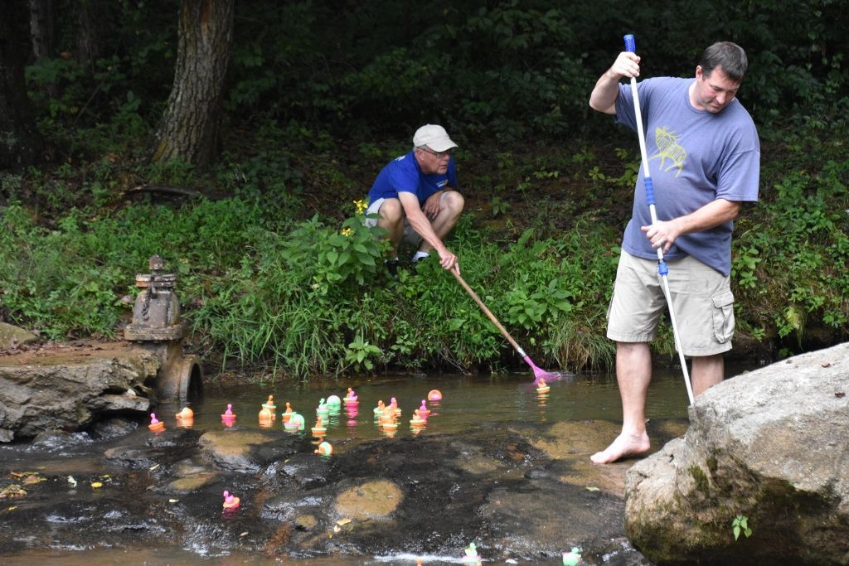
Burke-Sunrise Rotary Club had Scout demonstrate fly-tying at annual Duck Derby
North Carolina

Slide 6
Caribou Rotary Club recognized new Eagle Scout
Maine

Slide 7
Chester Rotary Club invited Scouts to provide update on activities & trailer Rotary gave them
Pennsylvania

Slide 8
Chitungwiza Rotary Club provided Scout Group with sun hats & land for nutrition garden
Zimbabwe

Slide 9
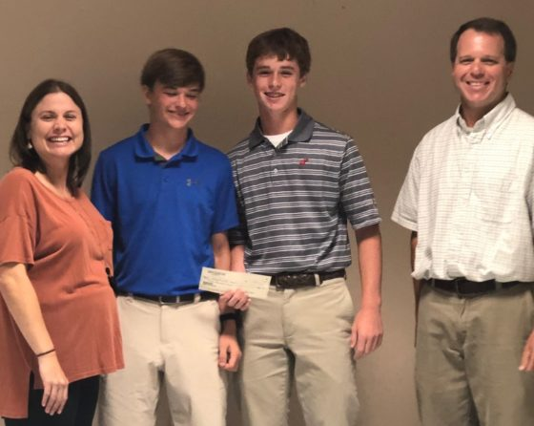
Demopolis Rotary Club invited Scouts to describe trek
Alabama

Slide 10
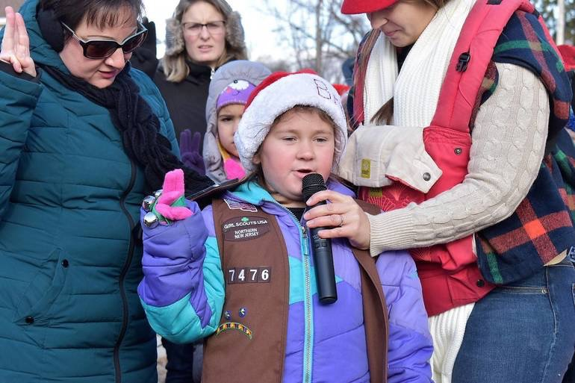
Denville Rotary Club invited Girl Scouts to sing at
Santa Land fund raiser
New Jersey

Slide 11
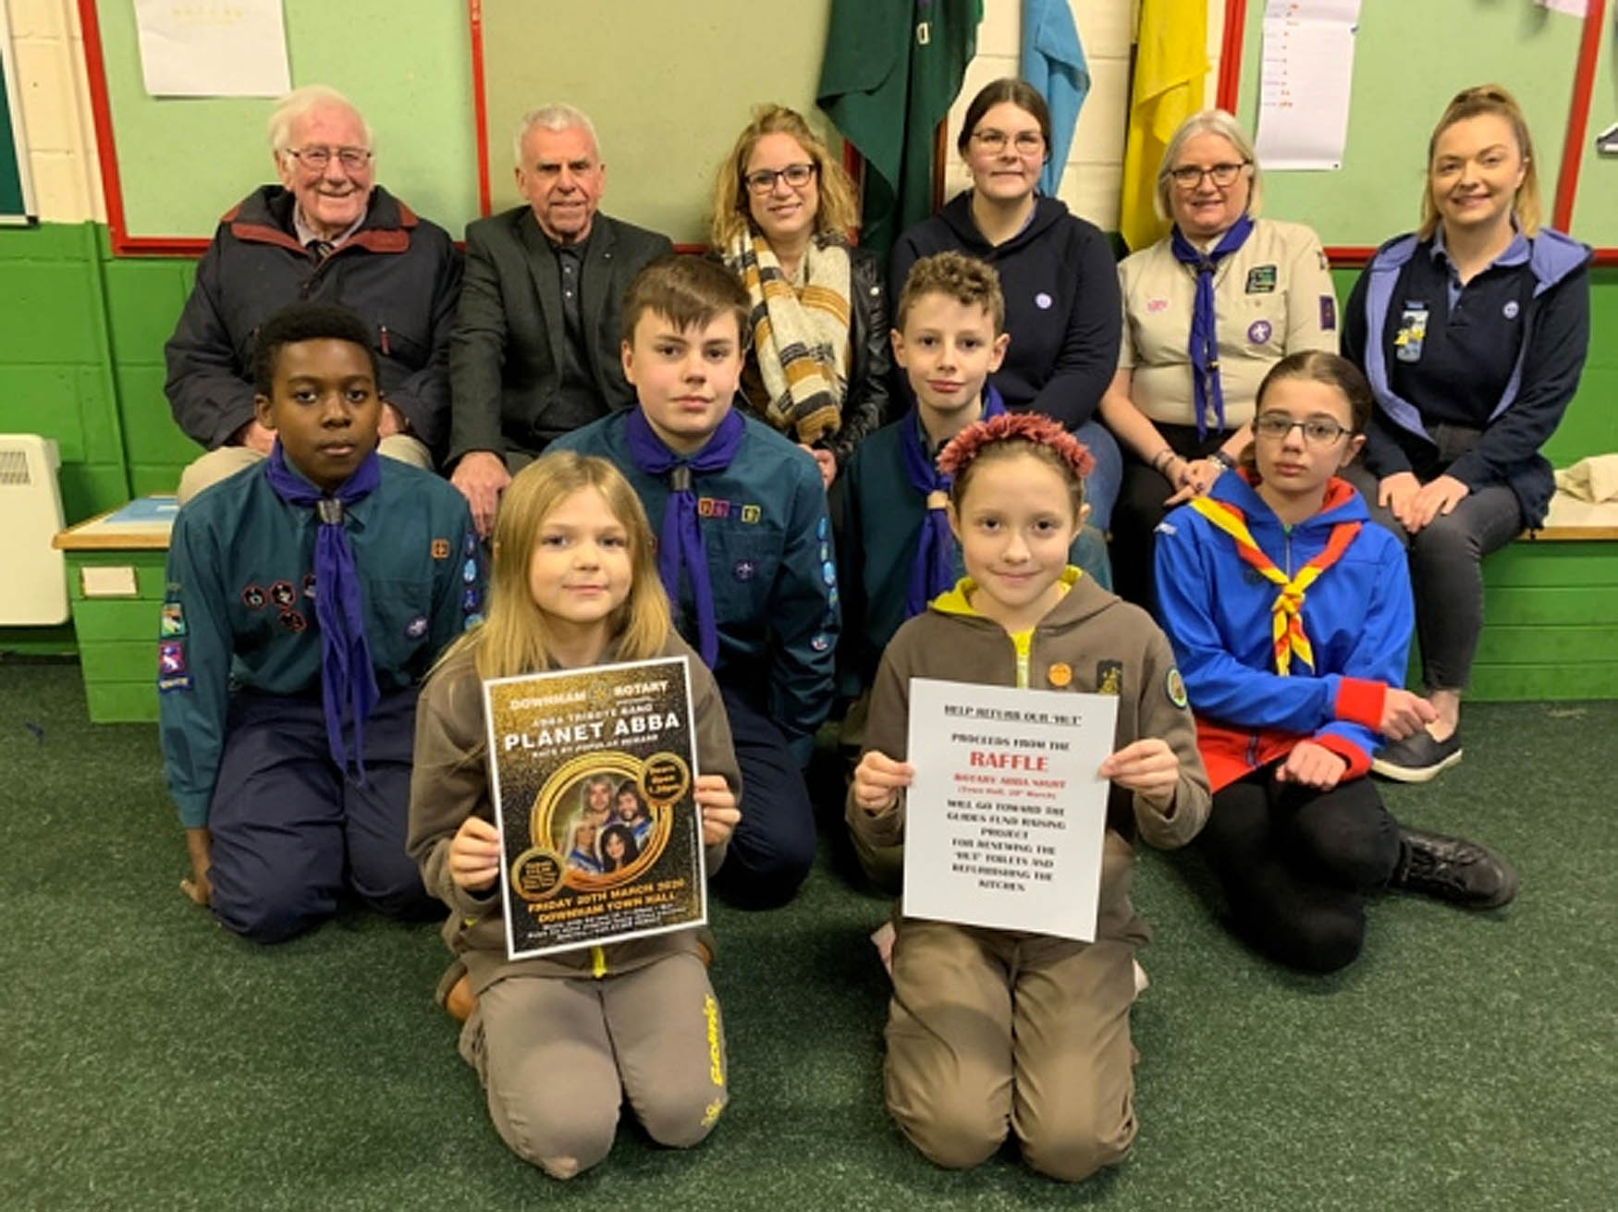
Downham Market Rotary assists Scouts, Brownies and Girl Guides
England

Slide 12
Duplin Rotary Club presented IFSR Community
Service Award to Scout Troop
North Carolina

Slide 13
Dursley Rotary Club contributes for room at Scout Hut
England

Slide 14
El Dorado Rotary Club invited Scout executive to provide update on Scouting
Kansas

Slide 15
Elkins Rotary Club hosted Belgian Scouts going to Jamboree
West Virginia

Slide 16
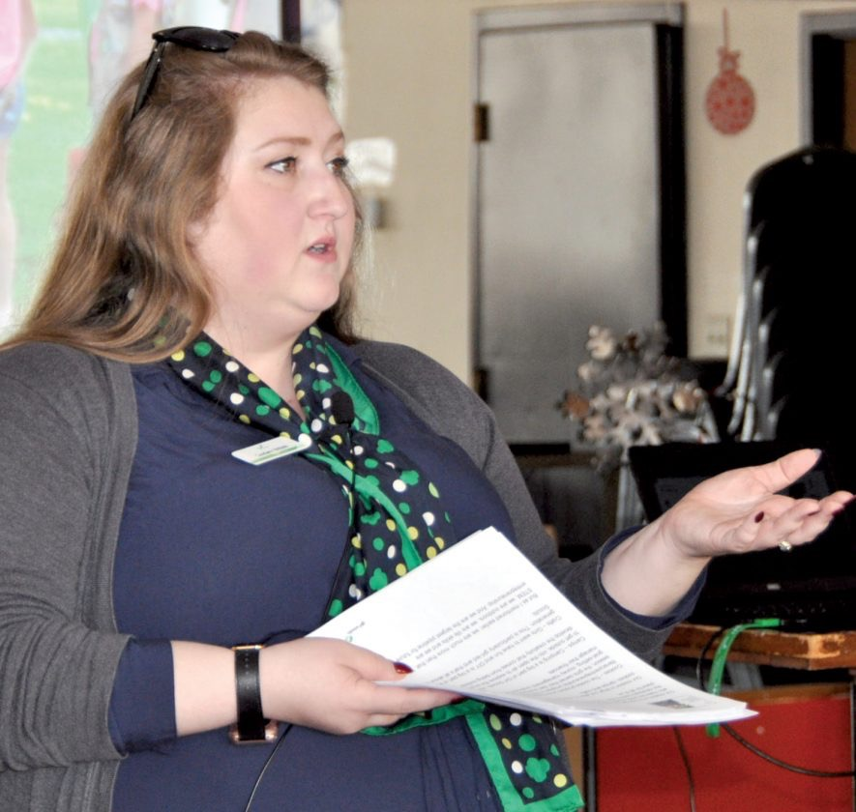
Elkins Rotary Club invites
Girl Scouts’
Marketing
Director to speak to Club
West Virginia

Slide 17
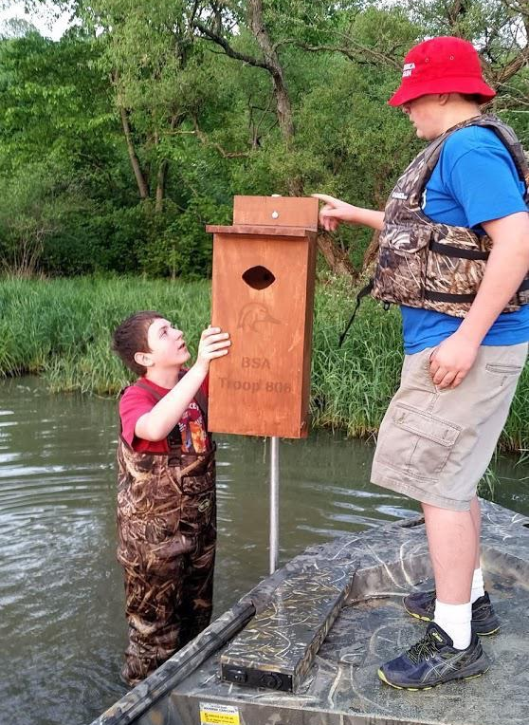
Ellwood City Rotary obtained grant for
Scout Troop’s
Conservation
Project
Pennsylvania

Slide 18
Escondido Rotary Club recognized Scouts who built
Serenity Garden for foster school
California

Slide 19
Geneva Rotary Club recognizes
Interact Club member who becomes
Eagle Scout
Ohio

Slide 20
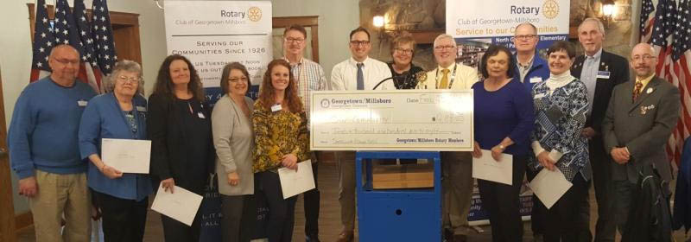
Georgetown-Millsboro Rotary provided camperships for Scout Troop
Delaware

Slide 21
Gosport Rotary Club funds Space Odyssey night for Girl Guides
England

Slide 22
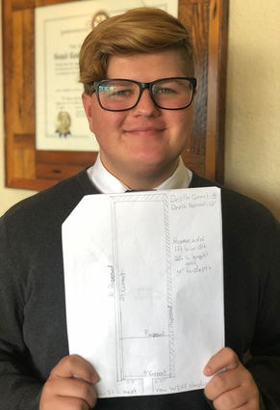
Grand Coulee Dam Rotary invited
Scout to describe his Eagle
Project
Washington

Slide 23
Great Falls Rotary Club honored Eagle Scouts & Gold Award Girl Scout at luncheon
Montana

Slide 24
Kenilworth Rotary Club helped with Eagle Scout project to build shed for Recreation Center
New Jersey

Slide 25
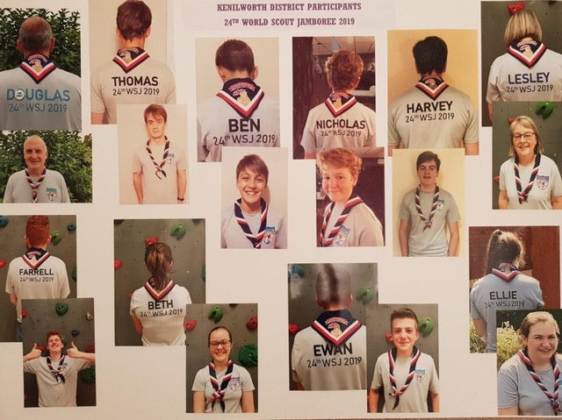
Kenilworth Rotary Club helped Scouts and Guides go to World Scout Jamboree
England

Slide 26
Where Rotary’s
Service Above Self
Joins with Scouting’s
Cheerful Service

Slide 27
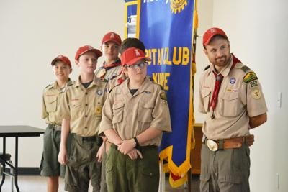
Kilgore Rotary Club had Rotary sponsored Troop report on its recent Food Drive
Texas

Slide 28
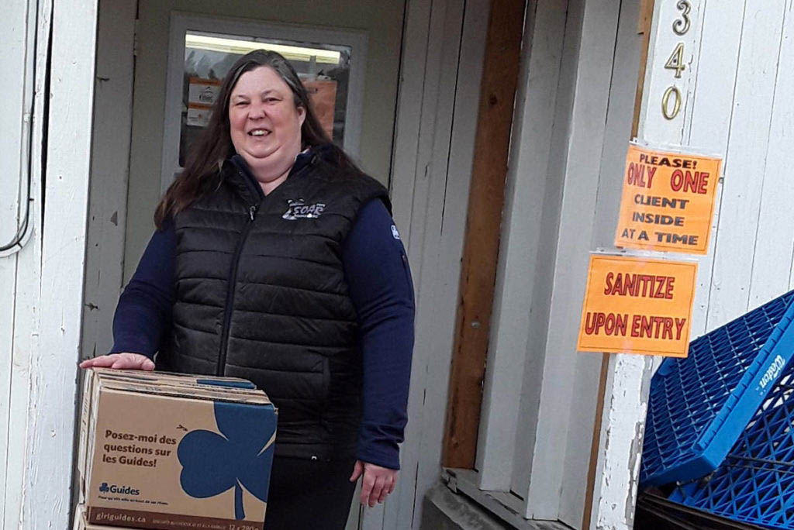
Kimberley Rotary Club purchased Girl Guide Cookies to donate to Food
Bank
Canada

Slide 29
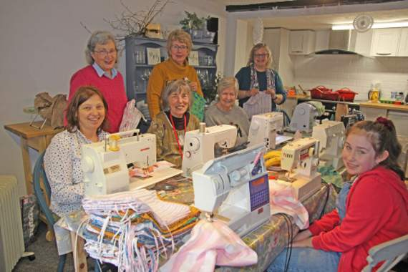
Launceston Rotary Club
& Girl Guides UK join to support Uganda Mission Project
England

Slide 30
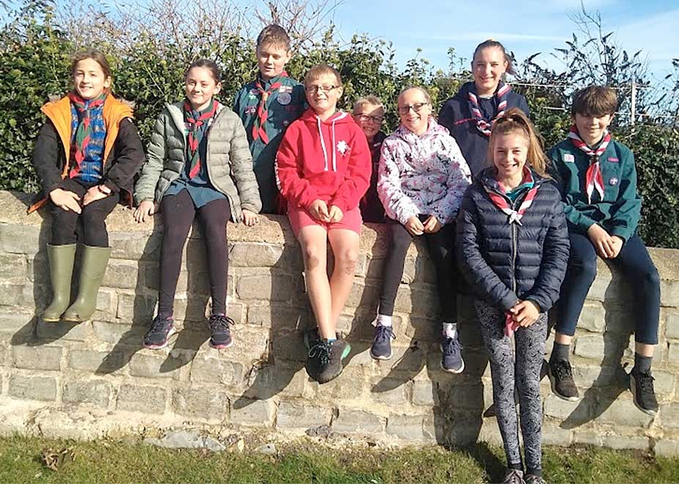
Lyme Regis Rotary Club let Scouts & Guides plant 4,000 bulbs in Rotary Purple4Polio garden
England

Slide 31
Madera Rotary Club supports Scout Civics Day Luncheon
California

Slide 32
Marshall Rotary Club invited Scout Executive to speak
Texas

Slide 33

Midhurst & Petworth Rotary used Elvis impersonator performance to raise funds to refurbish Scout & Guide hut
England

Slide 34
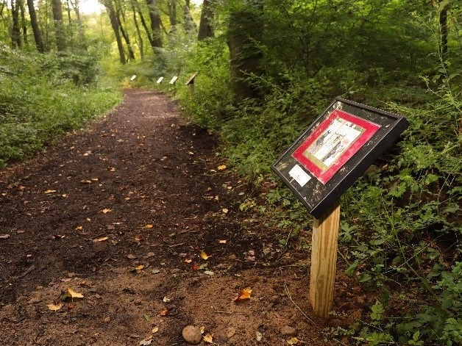
Milford Rotary Club sponsored Eagle project: StoryWalk trail
Connecticut

Slide 35
Napoleon Rotary Club sponsored Eagle project to build sign
Ohio

Slide 36
Newton-le-Willows Rotary supports Scout Group with sleigh donations from Christmas float
England

Slide 37
North San Bernardino Rotary let Girl Scouts sing & present cookies to Veterans at Rotary Christmas Party
California

Slide 38
O'Fallon Rotary Club joined with
Scouts &
Girl Scouts
to honor
veterans
Illinois

Slide 39
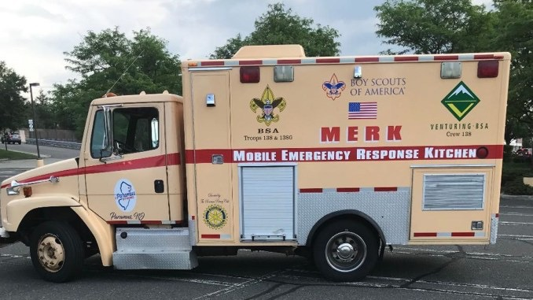
Paramus Rotary Club purchased ambulance for Scouts to convert into Emergency Kitchen
New Jersey

Slide 40
Pittsford Rotary Club purchased supplies for Girl Scout community service project
New York

Slide 41
Pontllanfraith Rotary Club provided electrical wiring & electrical heaters for Scout hut
Wales

Slide 42
Preston Rotary Club purchased supplies for Scouts to refurbish shelter
Idaho

Slide 43
Rowan Rotary Club awards Eagle Scout the
Service Above Self Award
North Carolina

Slide 44
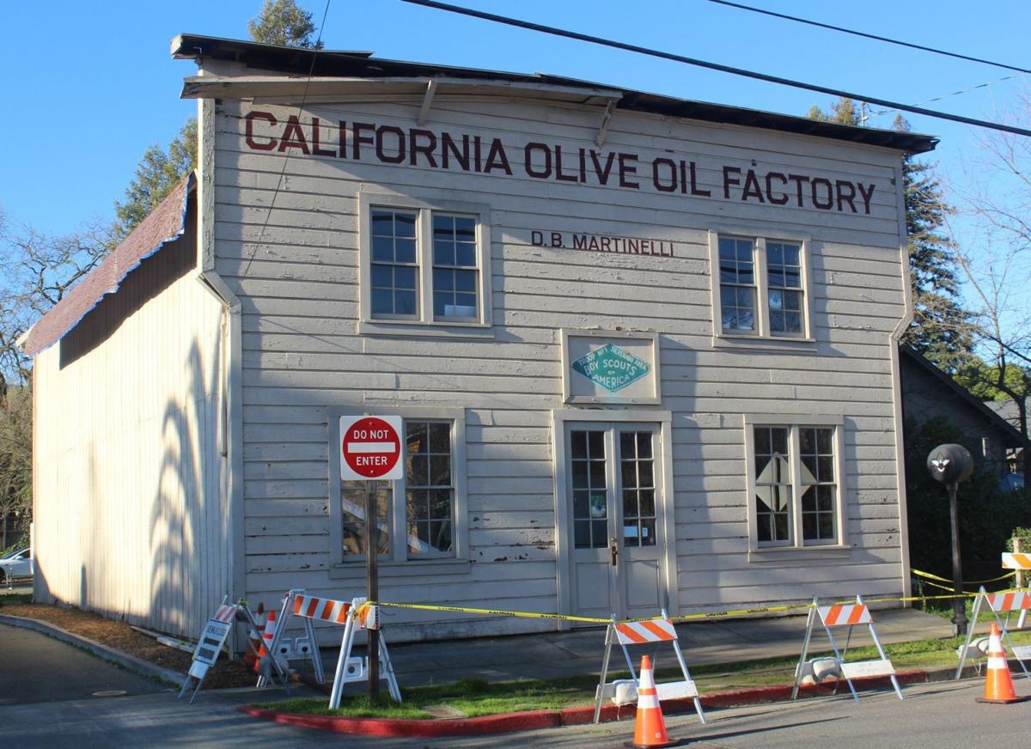
St. Helena Rotary Club funded improvements for Scout Hall
California

Slide 45
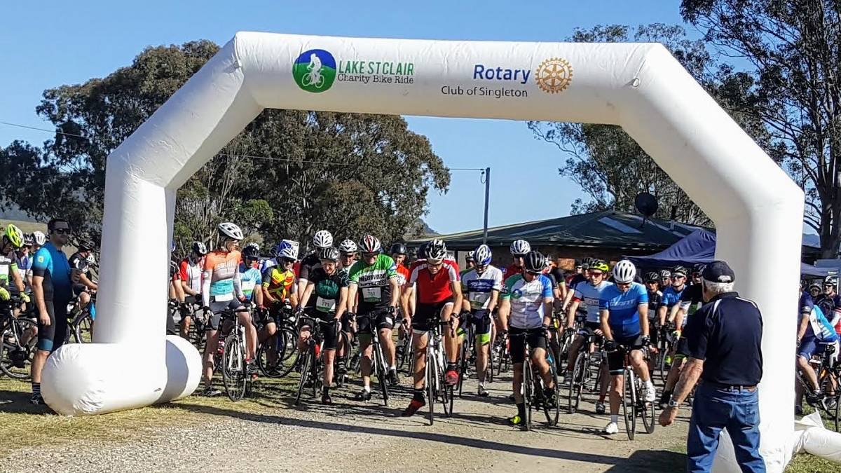
Singleton Rotary Club let Girl Guides run drink stations at Rotary Charity Bike Ride
Australia

Slide 46
Tallassee Rotary Club invited Girl Scouts CEO to Speak
Alabama

Slide 47
Wachusett Area Rotary Club sponsored
Eagle project to refurbish trail system
Massachusetts

Slide 48
Washburn Rotary Club held Court of Honor for Scout Troop sponsored by Rotary Club
Maine

Slide 49
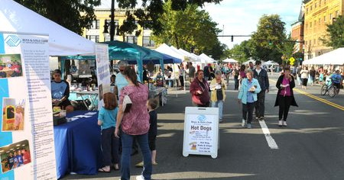
Westfield Rotary Club let Scouts provide climbing wall at Westfield Rotary Food Festival
New Jersey

Slide 50
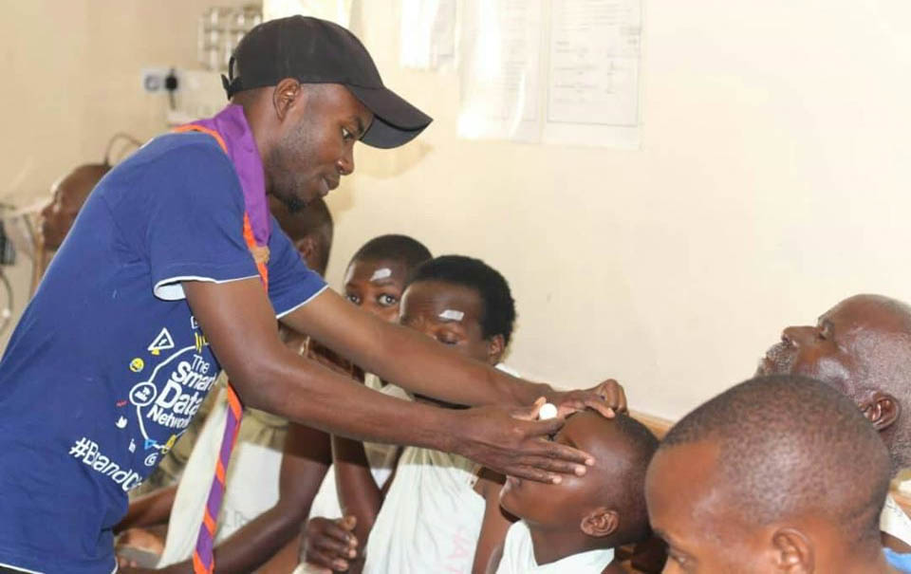
Zimbabwe Rotary Clubs’
Surgical Team assisted by
Rover
Scouts of
Zimbabwe
Zimbabwe

